Slide 1
SASK LONG COVID PARTICIPANT PORTAL
Stakeholder - Dr. Osgood
CMPT 371 - Team 2

Slide 2
Our Lovely Team❤️
Project Manager | Build Manager | Risk Manager | Dev Lead | Devs | Test Lead | Testers
Jeet | Riley | Hari | Ini | Chi, Dillon, Alex | Sashti | Vaidehi, Herv

Slide 3
Current State of the system
Currently, our system has the basic front-end navigation functionality, we have the general (skeleton) idea of how our styling might look like.
There are three pages: the welcome/home page, the registration page, and the dashboard/user profile page.
We hope to build on these three main pages in the next deliverable, focusing on connecting the backend and implementing the functionality of the dashboard page.
Notes:
After signing in from the home page, the user will be directed to the dashboard.
When the Register Now button is clicked, it leads to the registration page, which is currently a dead end as we do not yet have clarification on if we would be handling registration from our end and have someone authenticate it, or if someone (outside our system) does the registration for every participant and gives them their registration details.

Slide 4
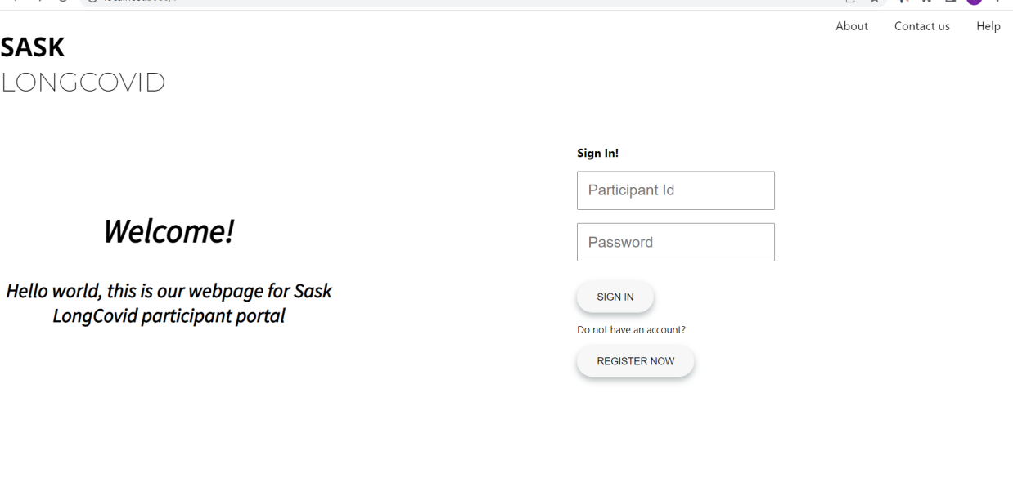

Slide 5
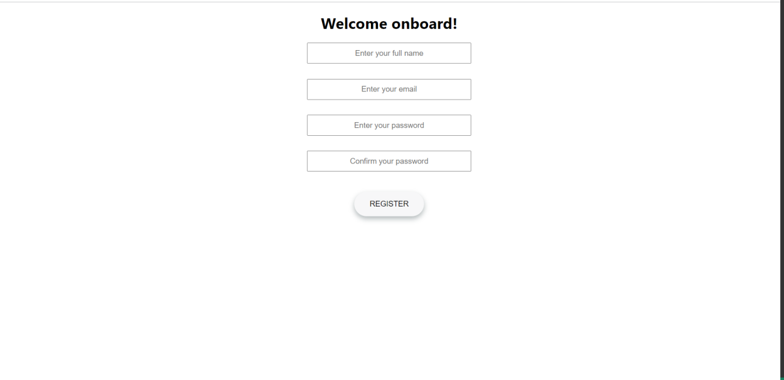

Slide 6
Changes or adoption in technologies
No changes to technologies used for app
We did decide to use figma for preliminary designs that we did not previously plan for
Used mainly HTML & CSS for the prototype
Bootstrap may be used for future deliverables

Slide 7
Prototyping
We decided to do our low-fidelity prototyping by creating sketches on a piece of paper.
We followed the 10+10 strategy to generate sketches for our Home Page, Login Page, and Register Page.
Our Work on next slide

Slide 8
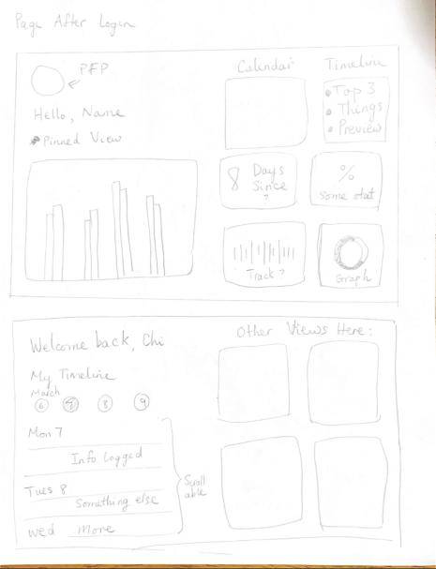
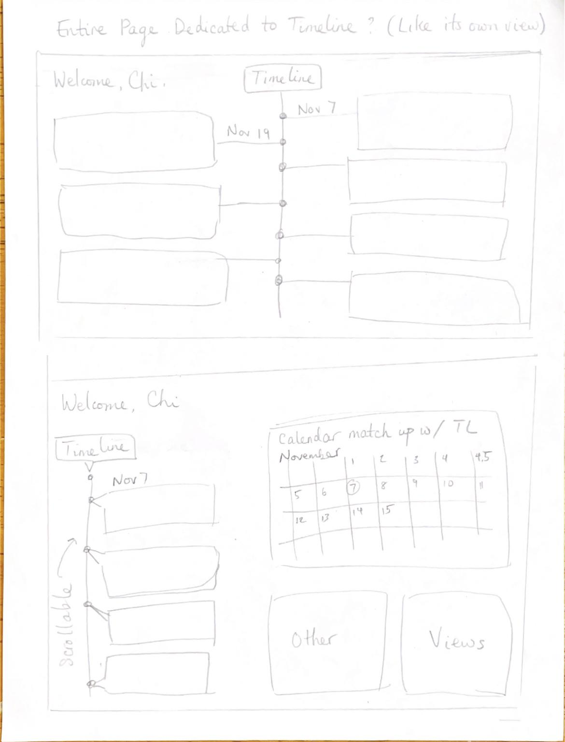
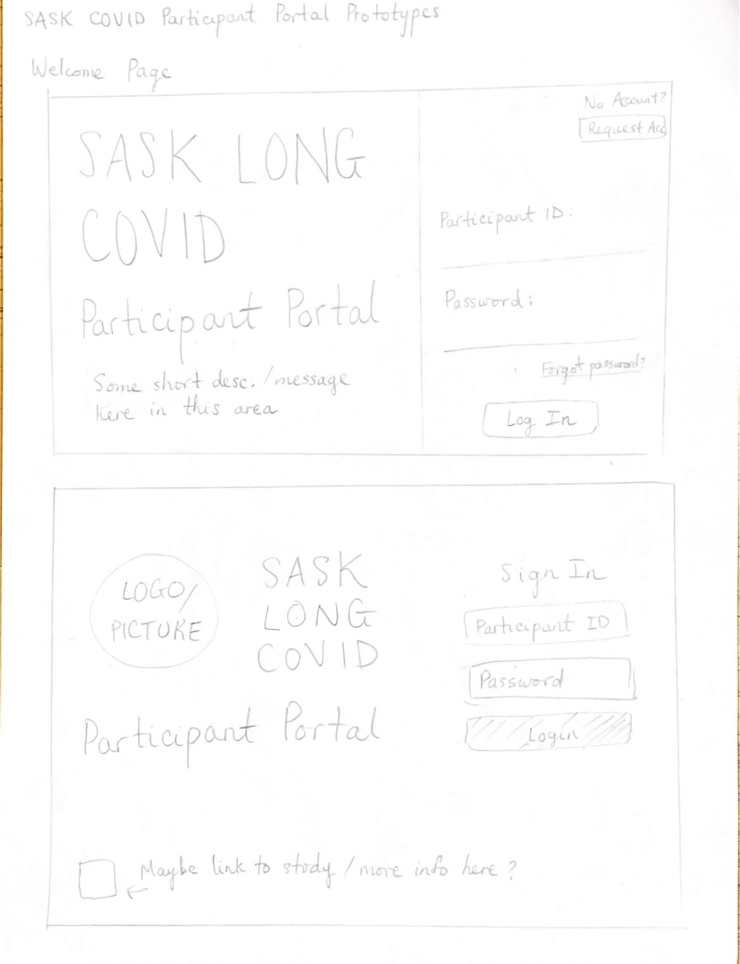
Prototypes (Low-Fidelity)

Slide 9
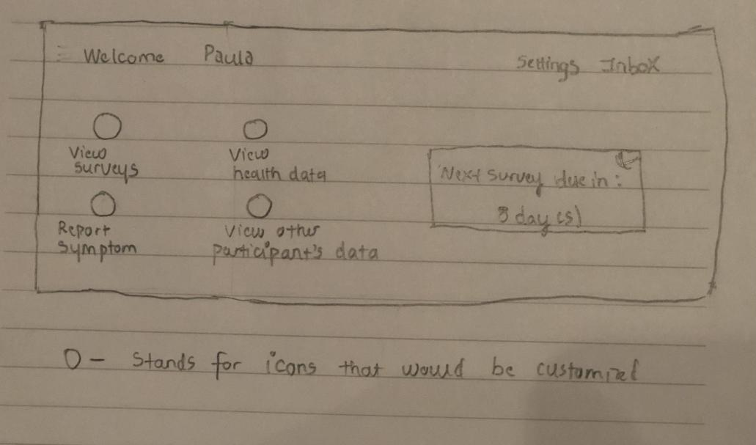
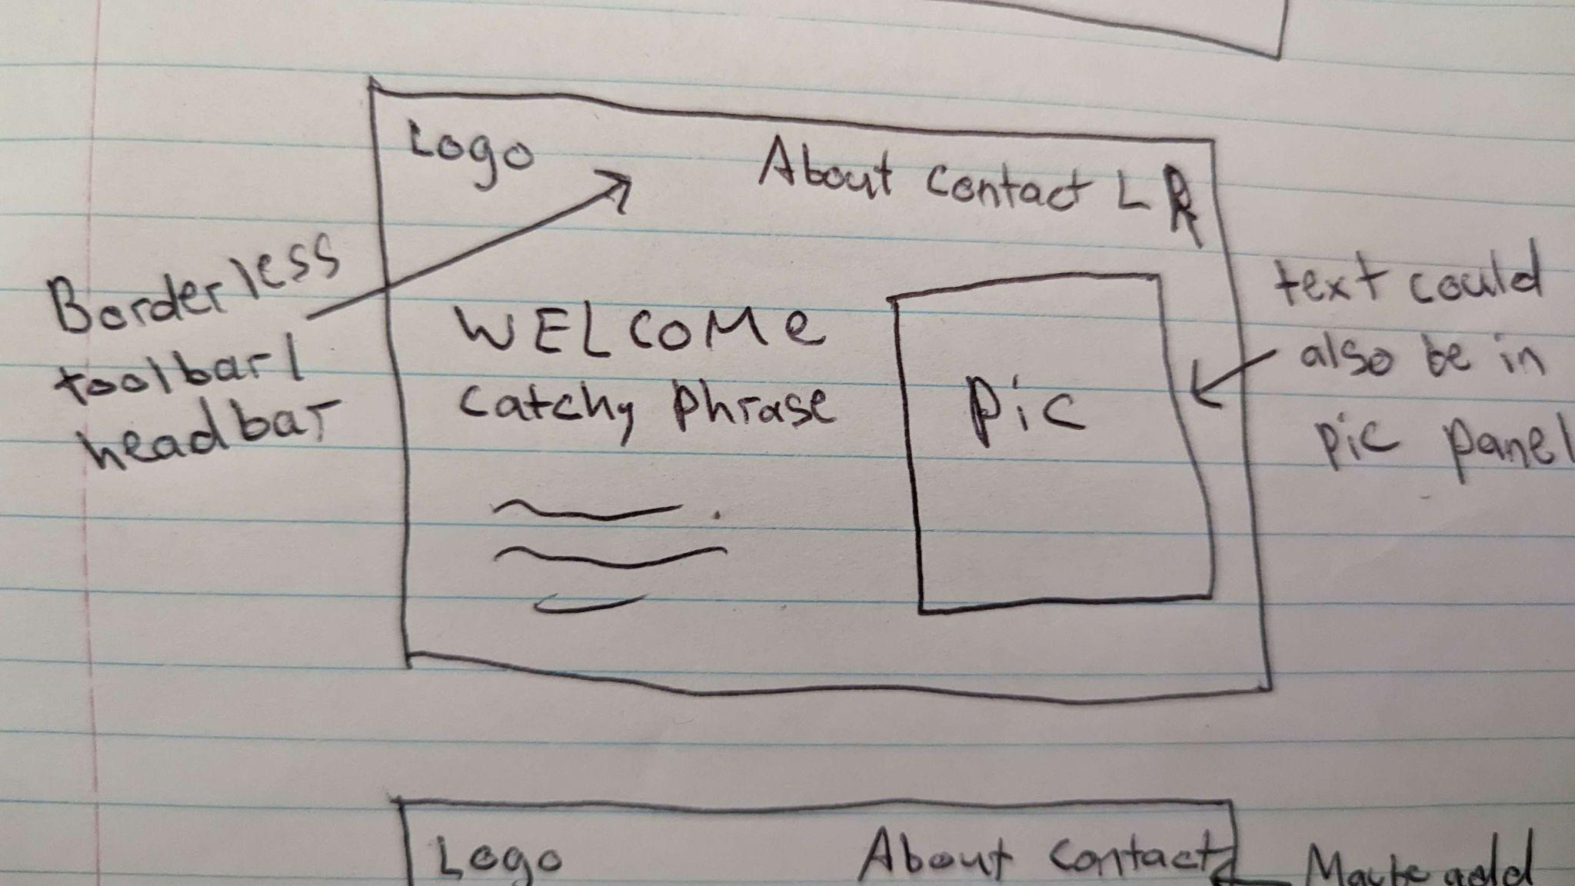
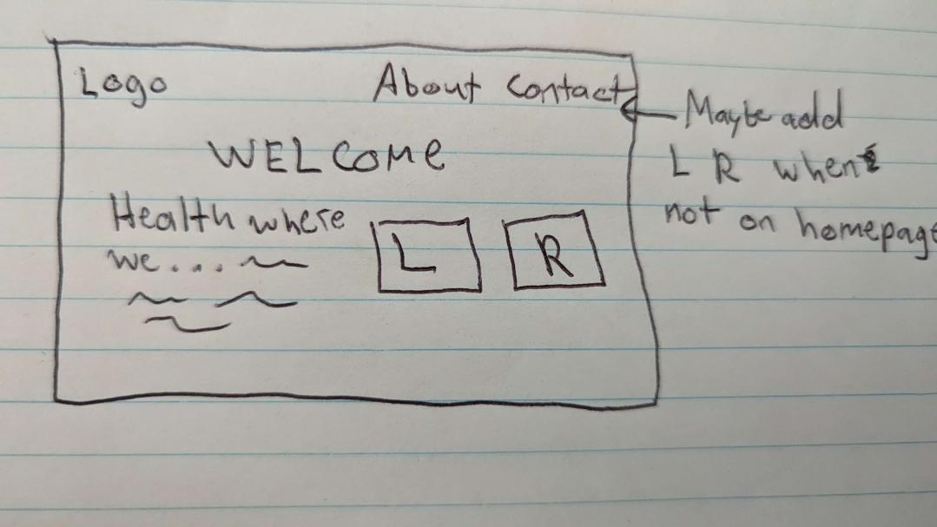
More sketches

Slide 10
Non-functional requirements
Making sure below non functional requirements are met
Security Speed
Performance Compatibility
Usability Availability/Reliability
Test Lead and Test Team are currently working on the testing developing tests.
There are some questions related to the implementation of some particular features. Which we will be discussing further with other team members later in team meetings.

Slide 11
Test Plan and Testing in Place
Our tests would test the functionality of the app, which mimics how it will be used by our end users.
Our test plan includes unit testing first along with a lot of integration tests.
These tests are done using Jest, which is a testing library in React.
Enzyme or other React testing libraries might be needed to test some components.
Continuous integration will be implemented so that we can automatically run our tests continuously. Travis CI would be our choice for implementing continuous integration.
Coverall gives us a coverage report that essentially gives us reports about how much of our code is being tested.

Slide 12
Potential Risks and its management
Commitment issues (dropped, busy, sick, no participation)
Merge conflicts
Learning curve
Communication & time management
Over/Underestimating the amount of work to be done for each component
Our app is not what the stakeholder/users imagined
Notes:
Learning curve
Was a big issue in the first deliverable. Specifically, when our development team met up to combine code we had a big issue setting up linking in between pages
Contingency plan enacted: We had 2 extra people not on the development team who had experience with react to meet with developers to help them out
Sent tutorial links
Shared screen to show how we are fixing the bug
Over/Underestimating the amount of work to be done for each component
When PM and TLs do their check-ins they see if the deliverable is on time or not
Doing scrum-ish meetings between each deliverable to get everyone to conclusively estimate the amount each user story will take
Mitigation strategy: We have people on stand by who know what is going on to lend a hand if anyone needs extra help to finish on time
ur app is not what the stakeholder/users imagined
Our PM and some others communicate with the stakeholder weekly to give updates and take feedback
We did 10+10 prototype development to get the best UI/UX we can

Slide 13
Tutorials given within the team
Tutorials for setting up Docker and VScode extensions were held by our build manager before the development cycles.
We have briefed our team on how to work with Git operations, how to use GitHub issues and actions.
More information on working on different branch and pushing it to the dev making sure all the tests pass will be given by one of our developers along with the dev lead, and build manager.

Slide 14
Quality Assurance Practices
Code Reviews: effective ways to catch bugs
Automated Testing: involves writing tests that can be run automatically to validate the code's behavior and catch bugs
Continuous Integration: automatically building and testing code whenever changes are made – help to catch bugs before the commit
Code Documentation: involves writing comments and documentation that describe the purpose and behavior of the code – good for future reference and code maintenance
CI: We have a buffer branch named “dev” that is an intermediary “main” branch for any code that is not considered ready for production. Any code pushed to this branch will have all the tests triggered through Github Actions.

Slide 15
Inspections and Peer Reviews
Requirements Review
Done after meeting with stakeholder
Specified what features need to be implemented & their priority
Requirements are fairly clear, but more details can be added to certain features, e.g. timeline
Might be good to break these down into smaller user stories
Code Review
Reviewed Code written for MVP: login, welcome, and dashboard page
Each dev worked on a different page, and we met to link them
Ran into a couple conflicts & worked to resolve them together
Should plan file structure better to reduce overlap & confusion

Slide 16

^{Thanks for watching.}
Team 2

Slide 17
Questions???

